Slide 1
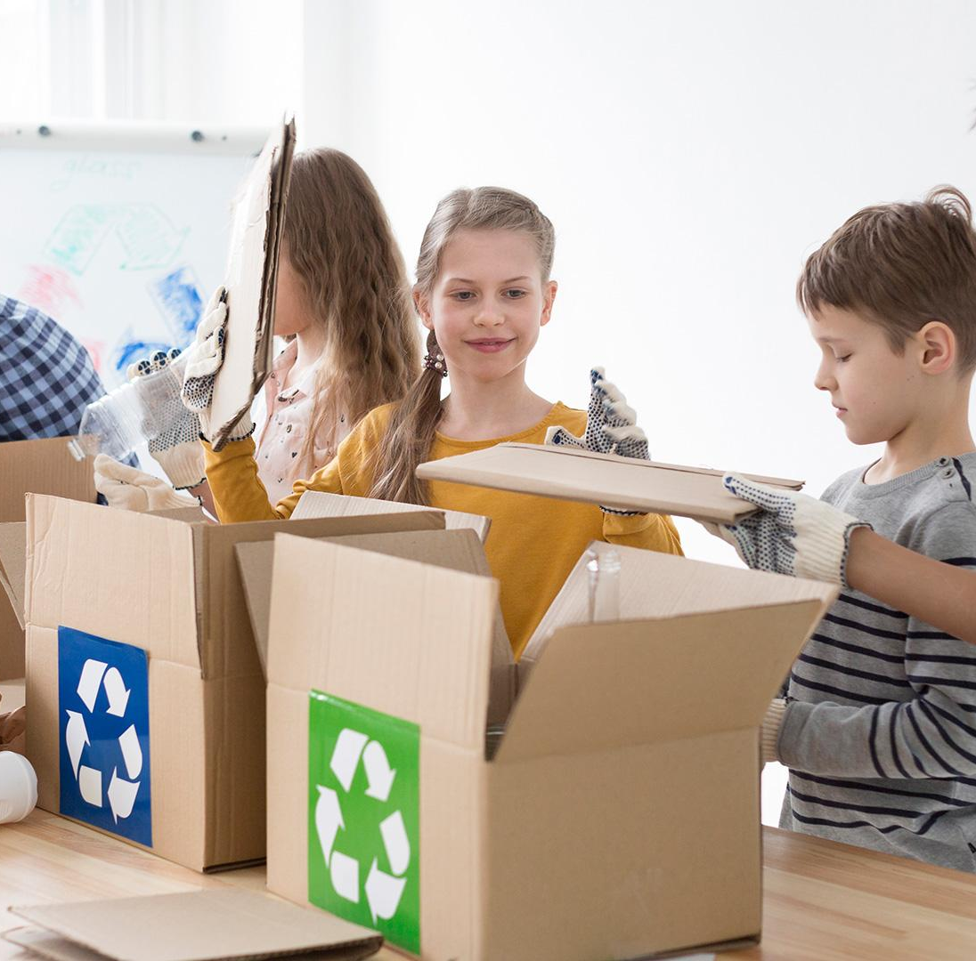

Project proposal
Group : 3B
Adham Yasser Albanna
Mostafa Wael Mohamed
Mohamed Ahmed Abd-Elkader

Slide 2
Introduction:
Egypt's agriculture sector is a cornerstone of its economy, employing a significant portion of the population and providing essential food supplies. However, despite its importance, the sector faces numerous challenges that hinder its full potential.

Slide 3
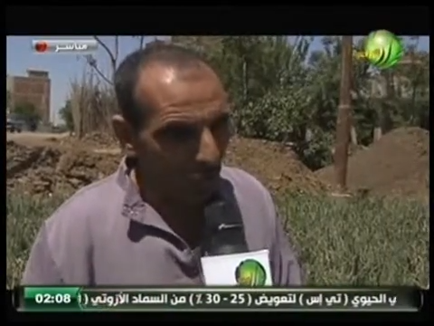

Slide 4
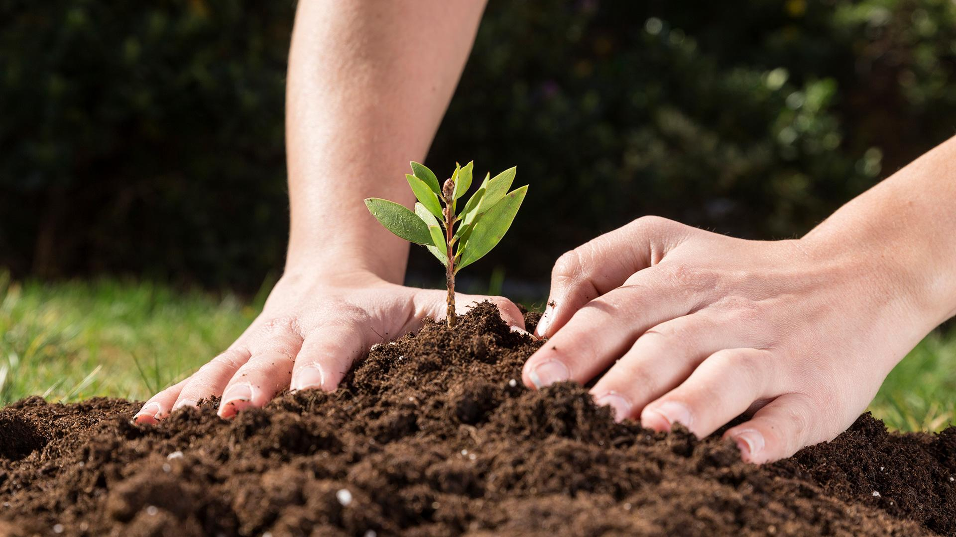

Agro- cycle
"Sow Together, Share Forever"
"Fields of Change:
Insights into the Agro-Cycle"

Slide 5

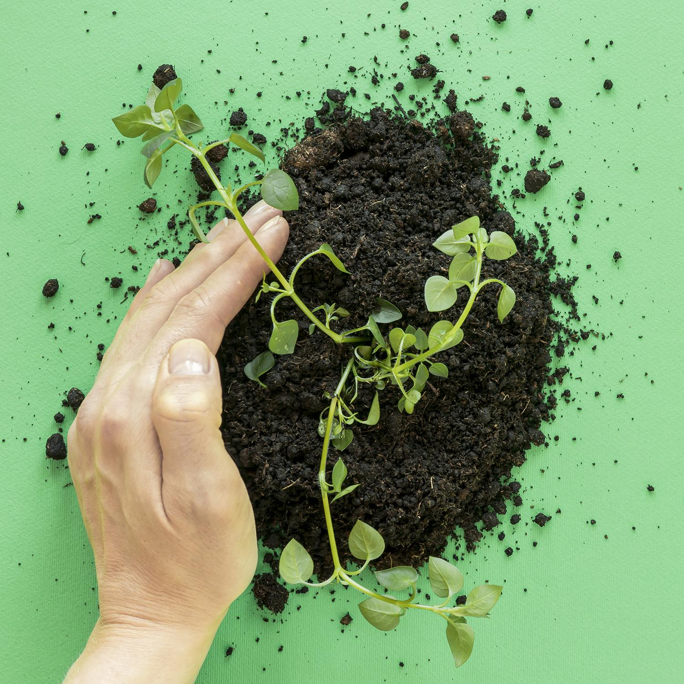

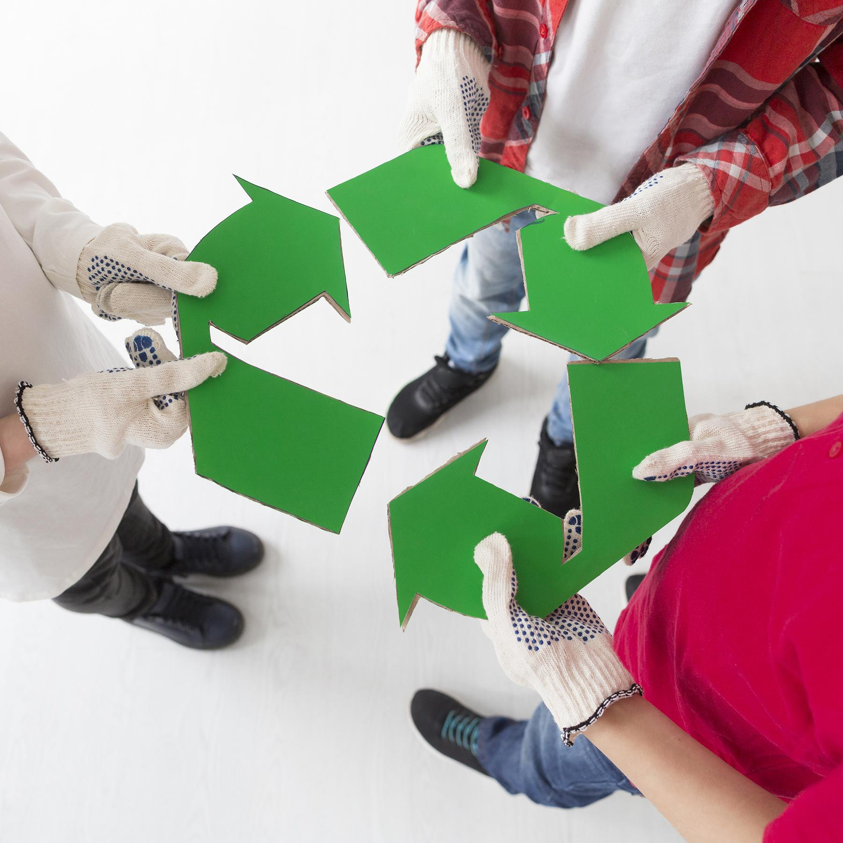
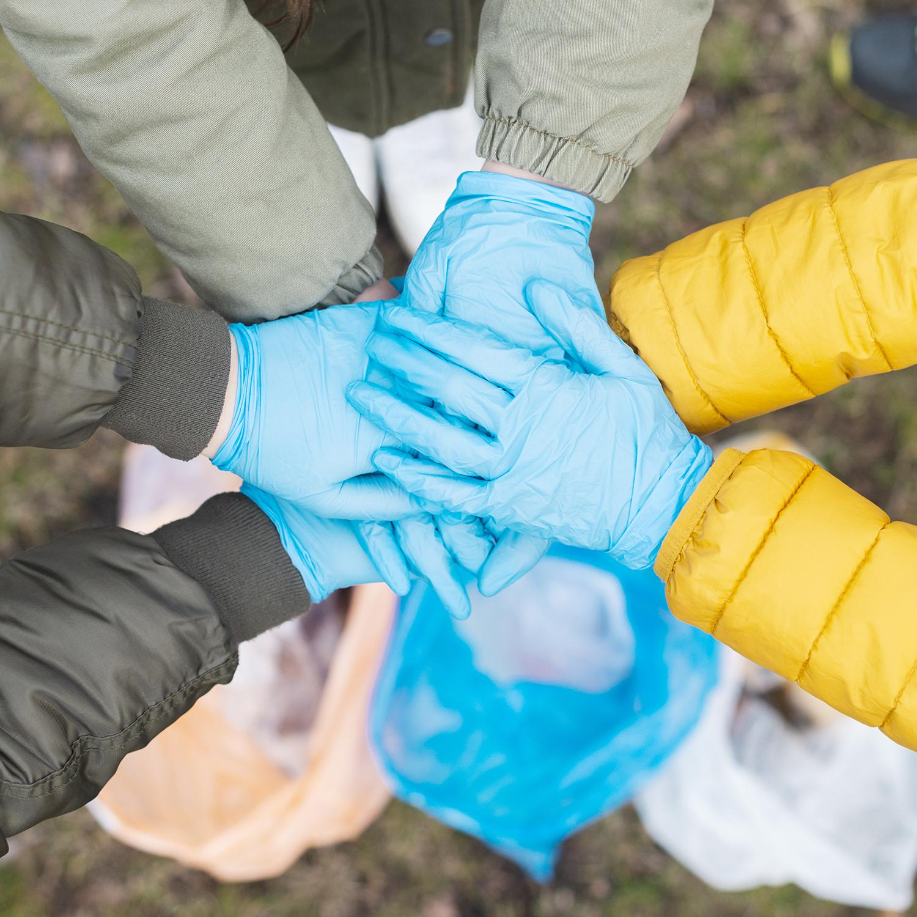
Main problem
Main objective
The huge gap between the farmers and the stock market
Direct Marketplace to enhance transparency, and efficiency.
sub problems
Sub objectives
Wastage of left over materials
Fragmented Market
Price Volatility
Supply Chain Inefficiencies
Reusage of left over materials by re-offering them again on the platform.
Quality Assurance
Fare Pricing

Slide 6
Sc pe
The app aims to establish an efficient and transparent marketplace that connects farmers directly with restaurants, factories , Companies, and markets.
It facilitates the seamless exchange of produce, services, and information, while promoting sustainability and reducing wastage. Through features such as inventory management, ordering systems, communication tools, and payment integration
The app streamlines the entire process from farm to table.
01
02
03

Slide 7
Visi n
Our vision is to revolutionize the agricultural supply chain by empowering farmers and consumers alike.
01
We envision a future where farmers have direct access to markets, consumers have access to fresh products and local sources, keeping all crops from waste and preserving the environment, and sustainability at the forefront of agricultural practices.
02

Slide 8
Mission
01
02
Bridge the gap between farmers and consumers
Empower farmers
03
Accessing to high-quality, locally sourced products

Slide 9
Importance of the Idea:
01
Empowering Farmers
02
Promoting Sustainability
03
Supporting Local Communities
04
Enhancing Food Security
05
Improving Efficiency

Slide 10
Challenges
security
Make our application secured as possible
spread
The spread of our application among farmers, knowing that not all of them are very familiar with technology

Slide 11
Benefits:
For farmer
Increased income through
direct sales
Access to a broader market
Better planning with market
insights
For Buyers:
Reliable source of quality produce
Transparent pricing
Reduced costs by cutting out intermediaries
Public Benefit:
Market Regularization.
Reduction of Waste.
Fair Pricing.
By reorganizing the relationships between sellers and buyers, we will achieve self-sufficiency and reduce the rate of agricultural product imports, paving the way for local manufacturing to begin an era of exporting rather than importing.

Slide 12
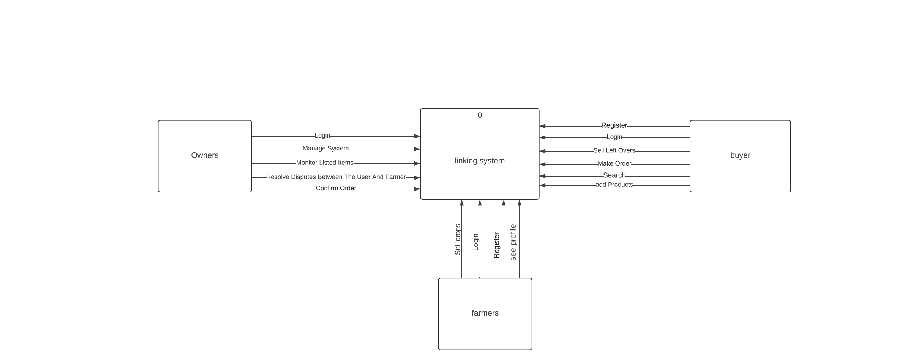
Context Diagram

Slide 13
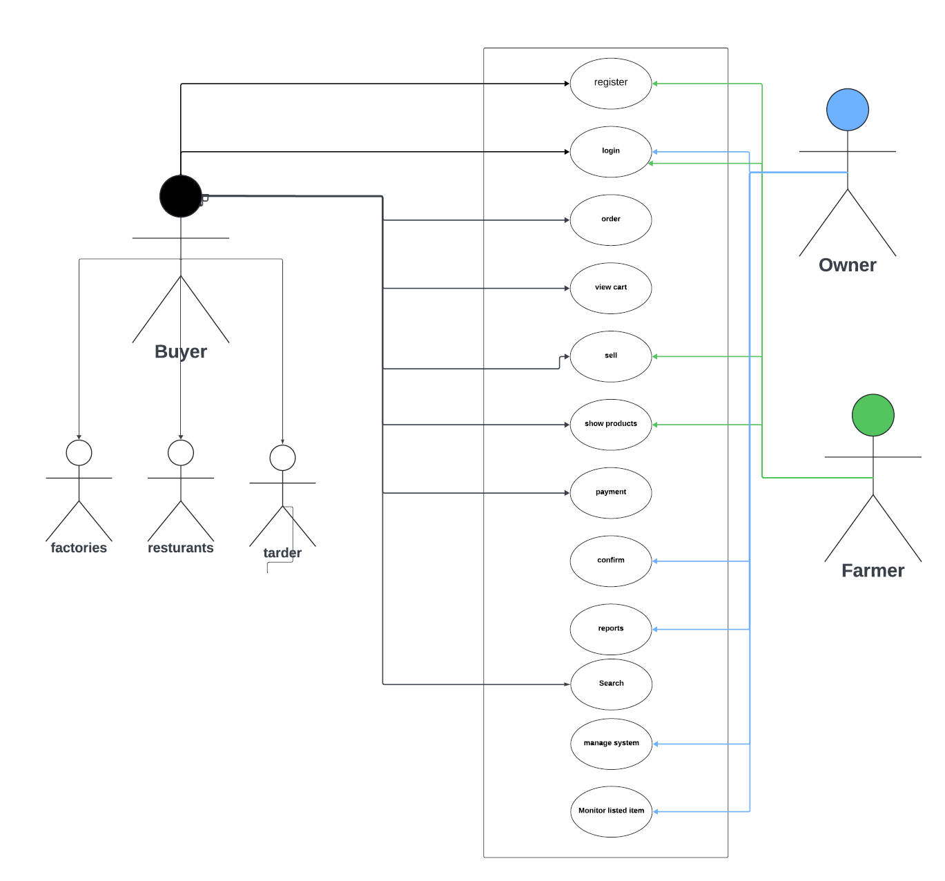
Usecase Diagram

Slide 14
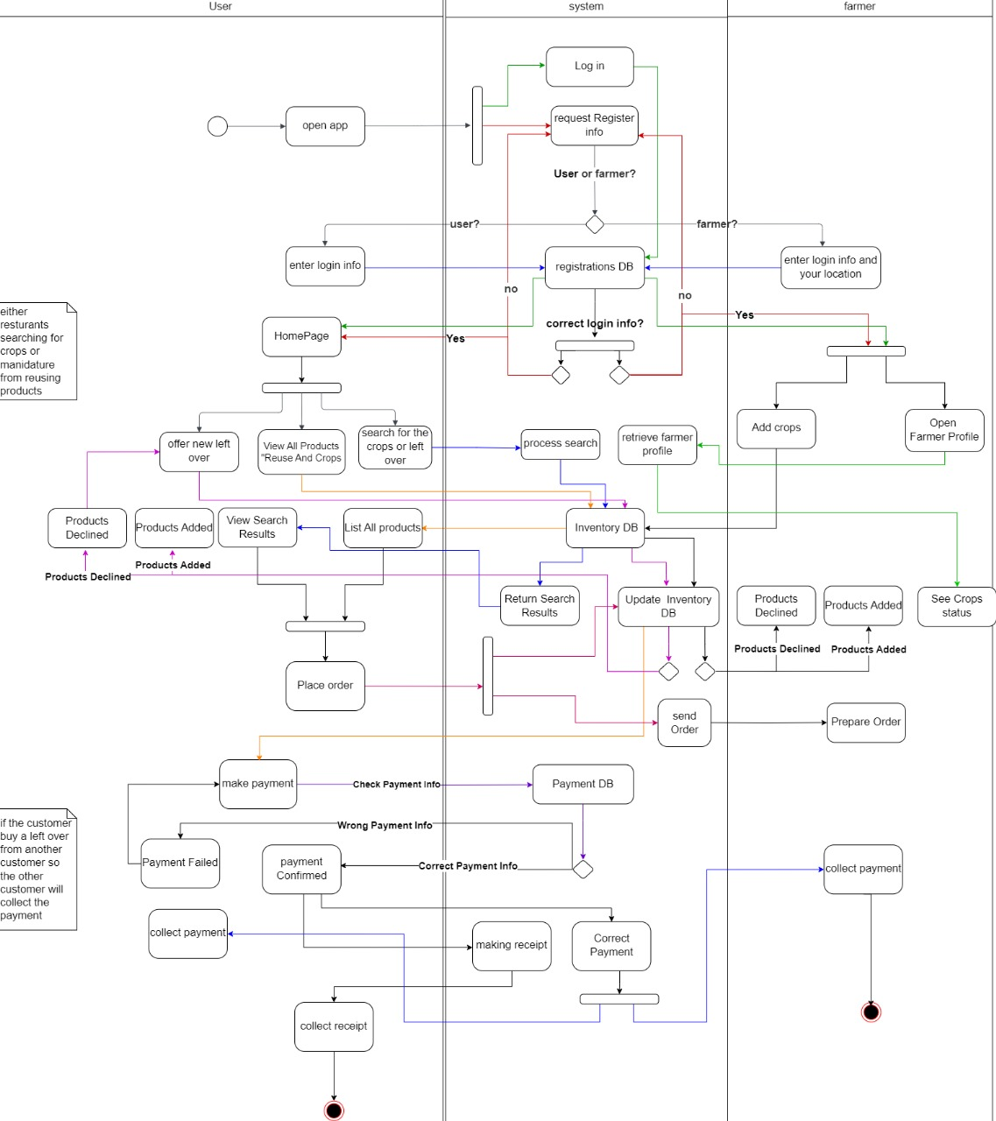
Activity Diagram

Slide 15
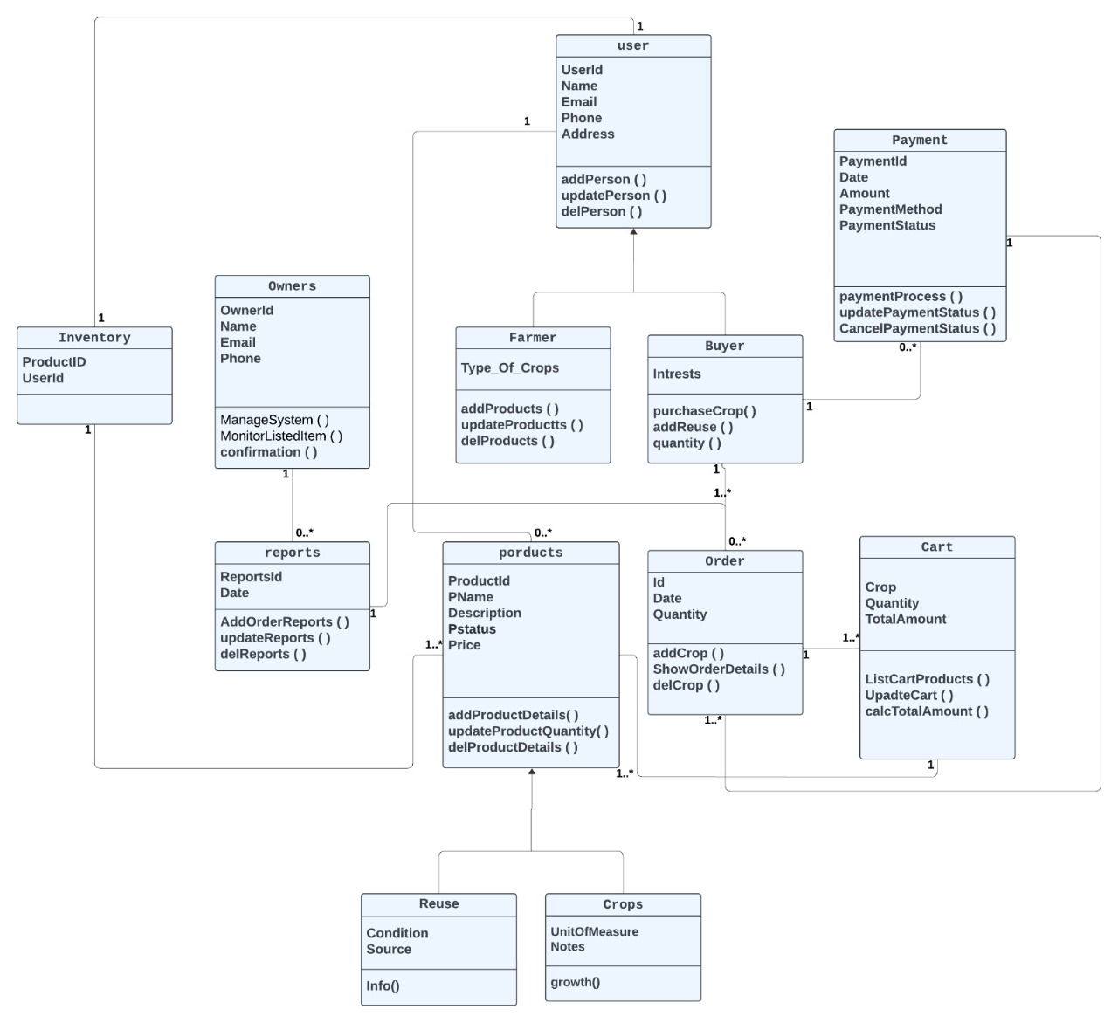
Class Diagram

Slide 16
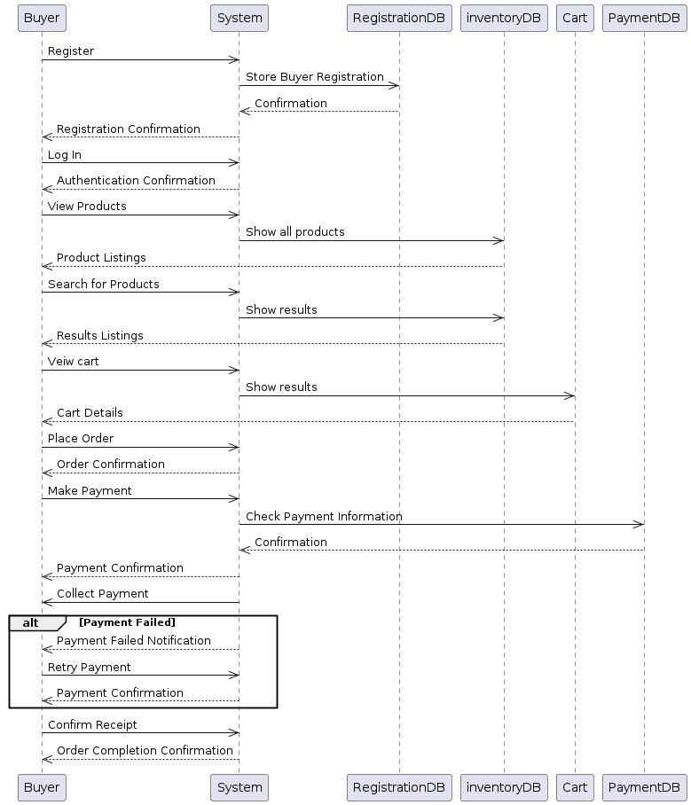
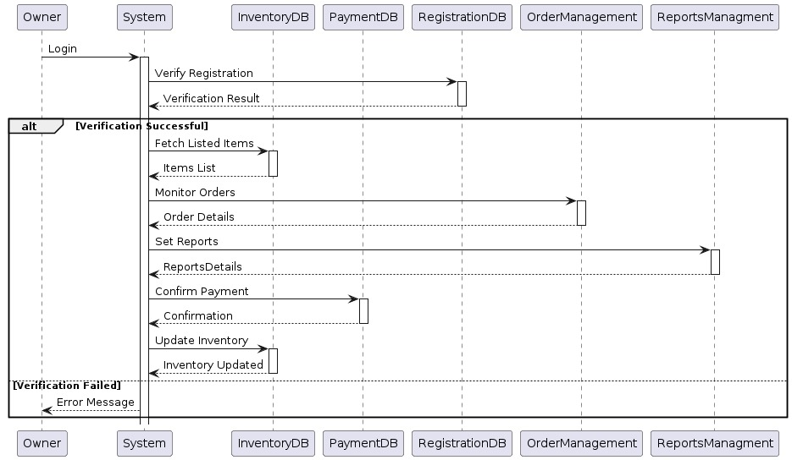
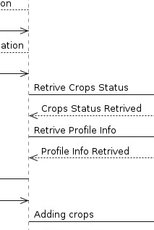
Sequence Diagram

Slide 19


Slide 21
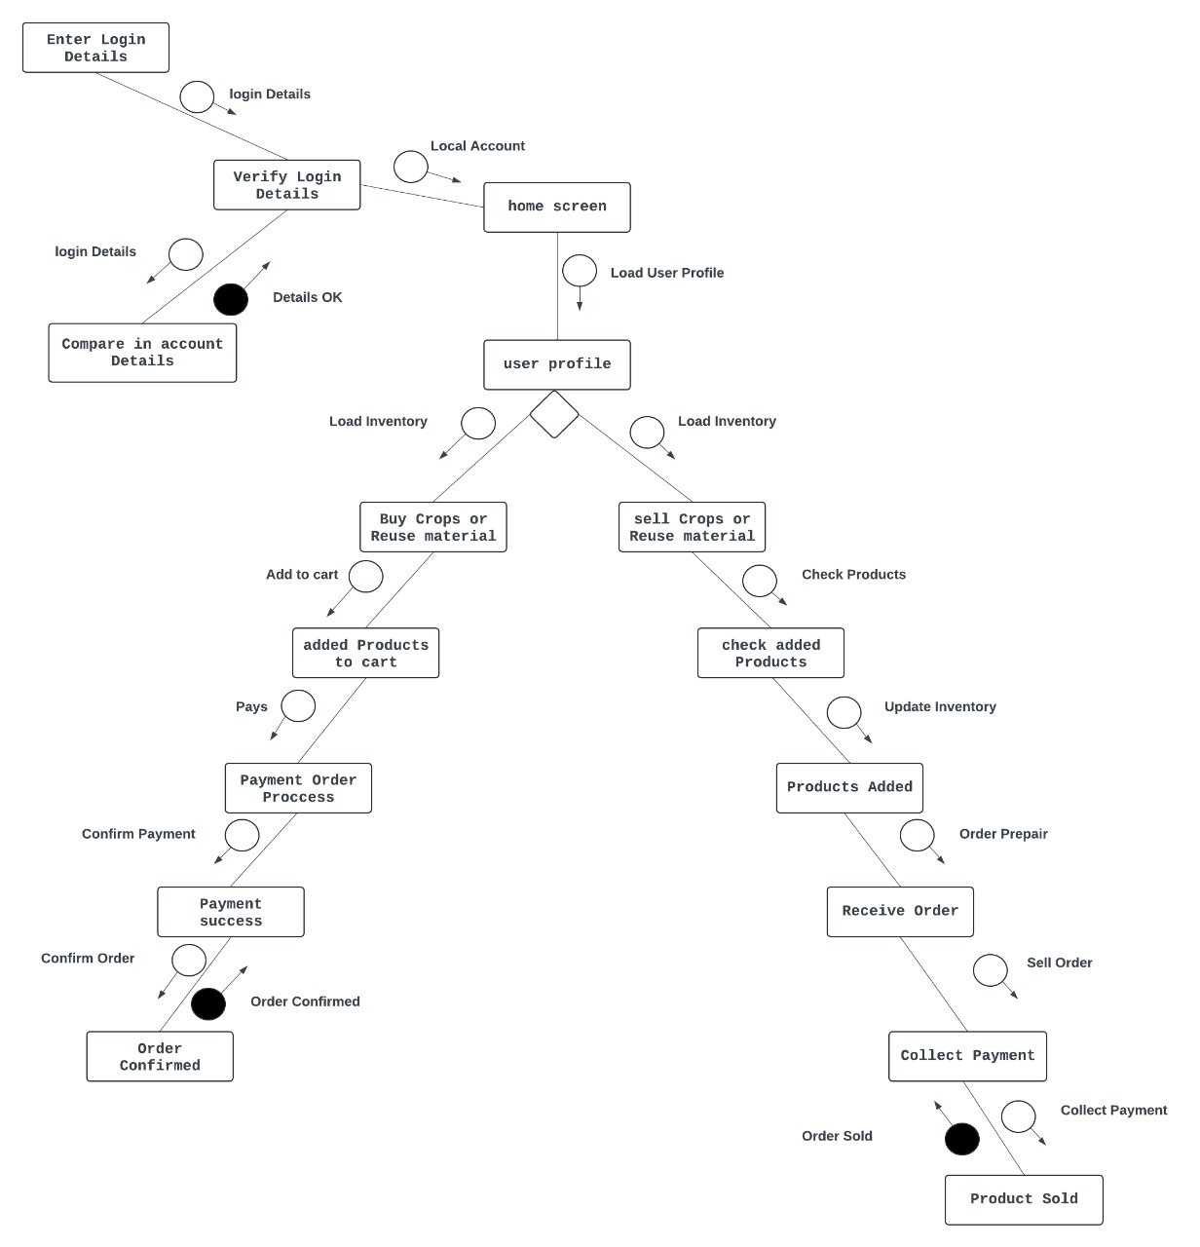
Structure Diagram

Slide 22
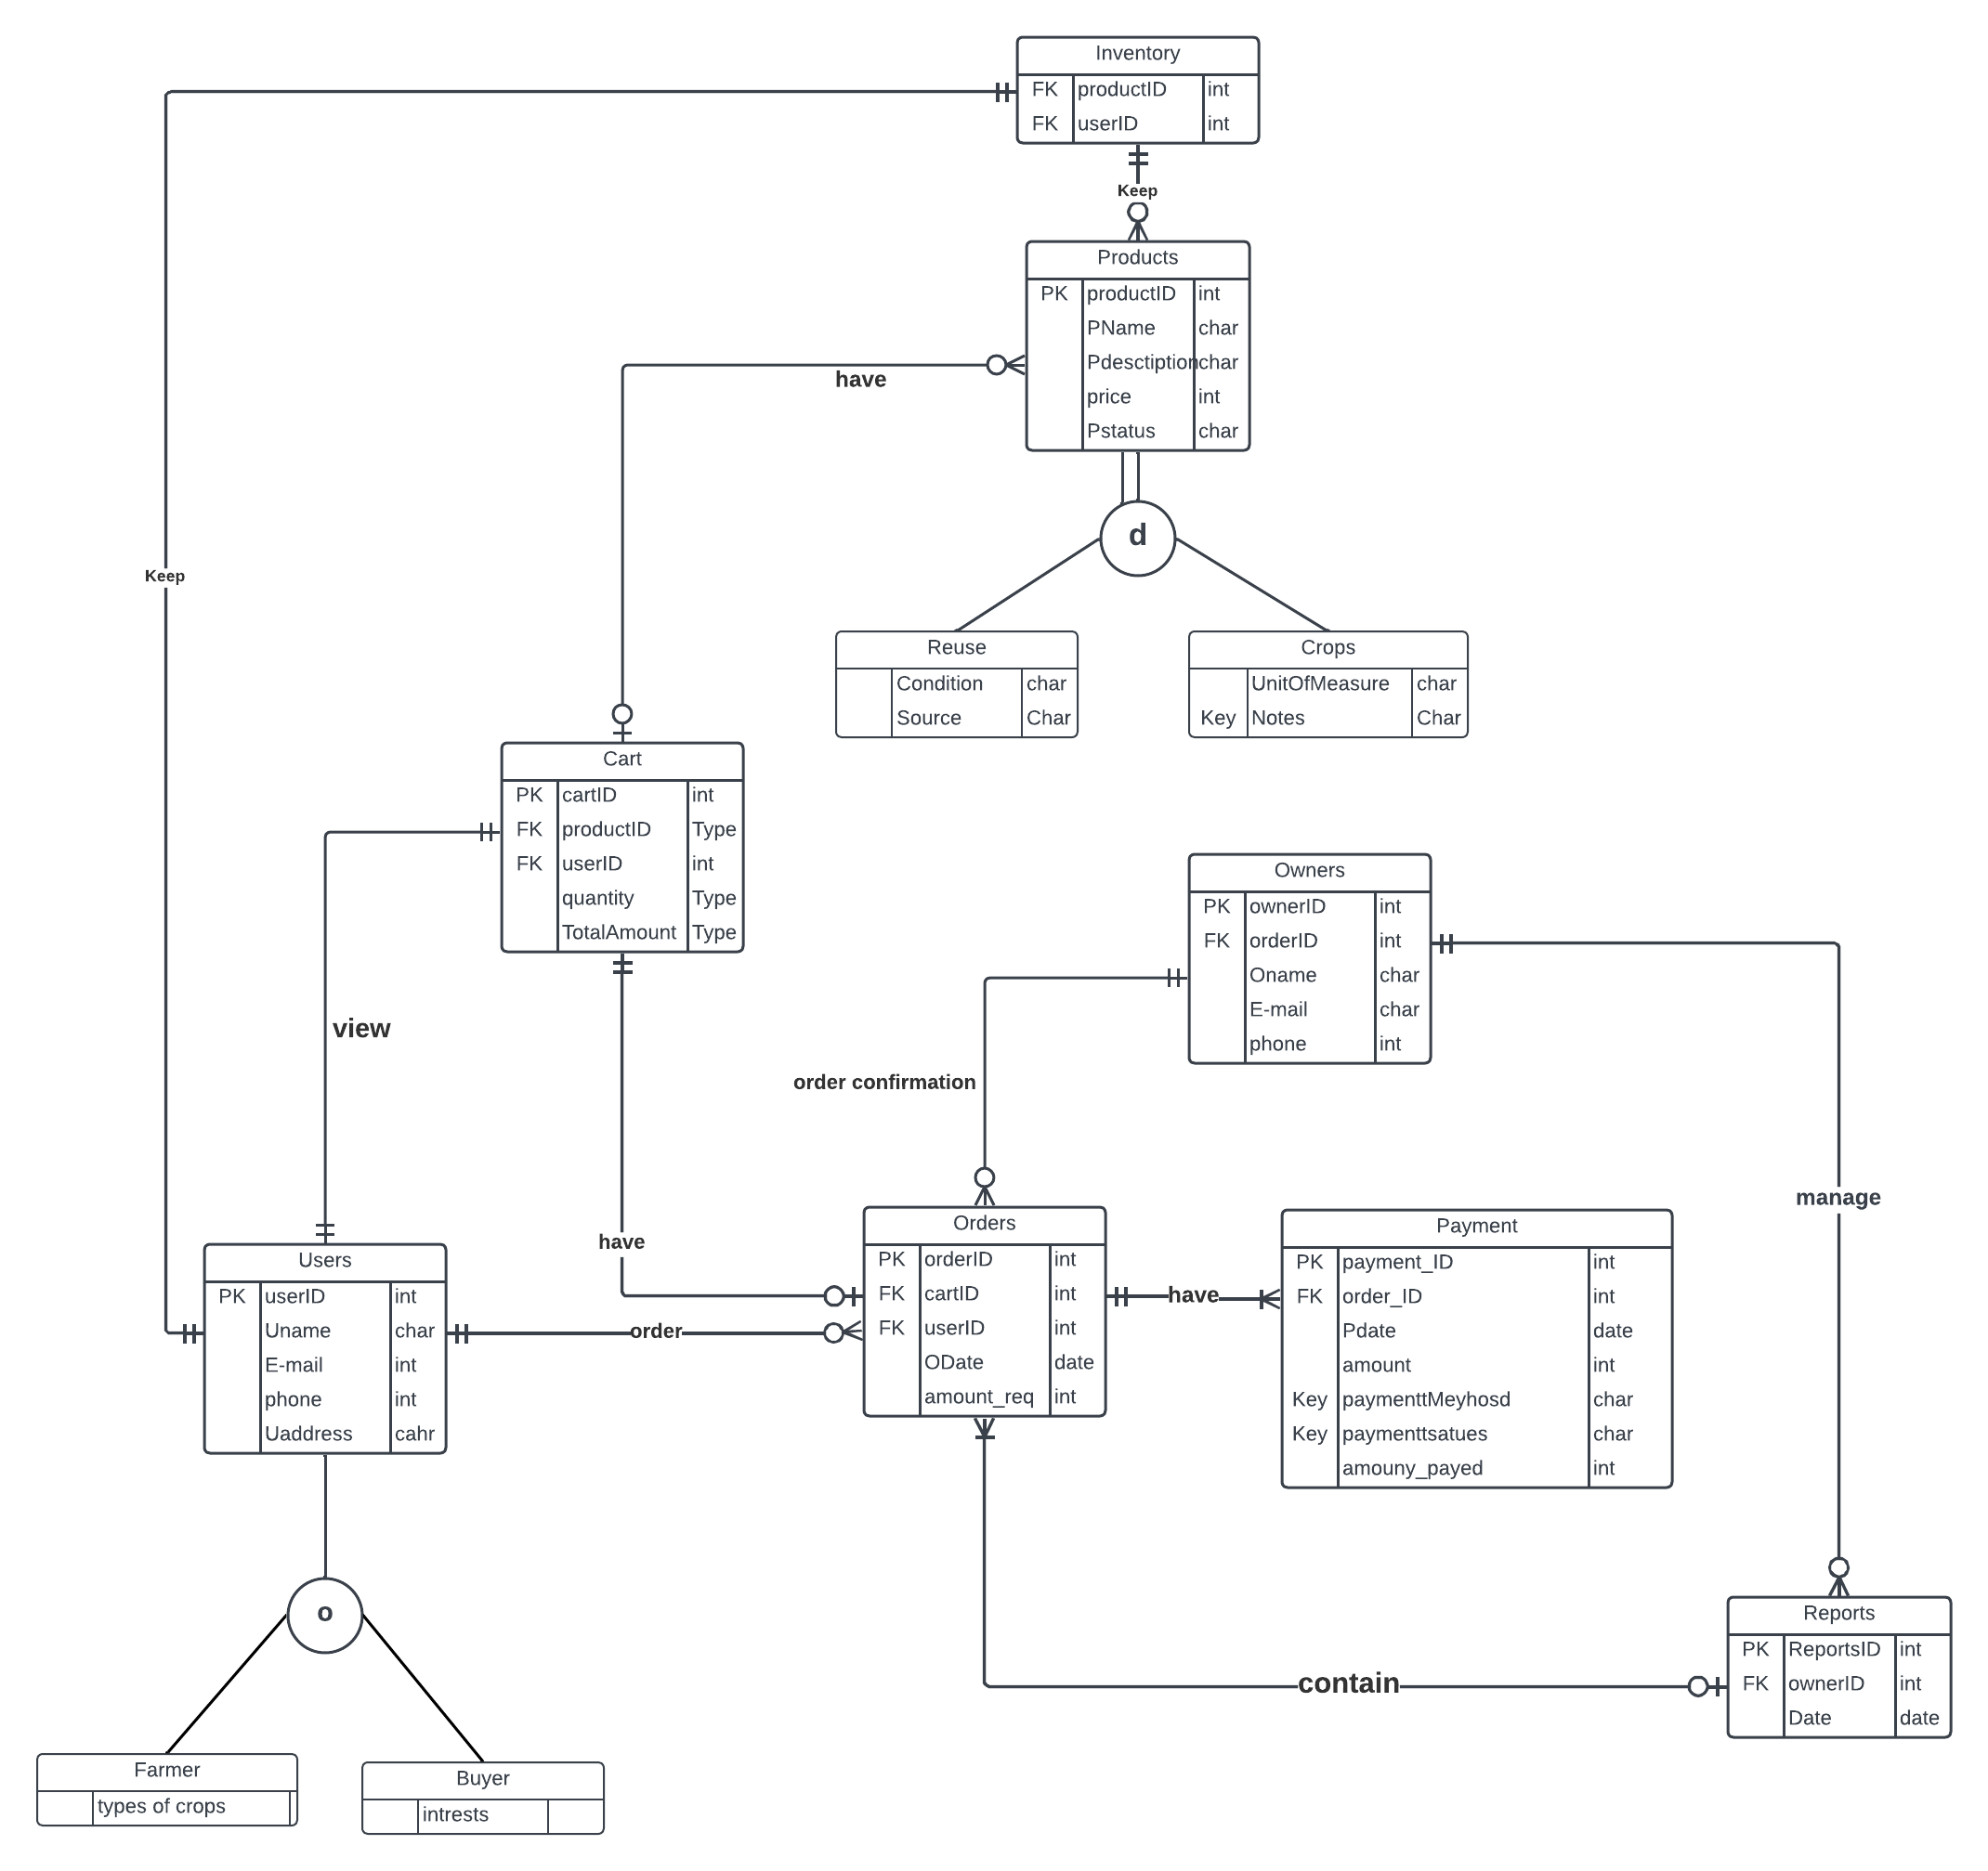
ERD

Slide 23
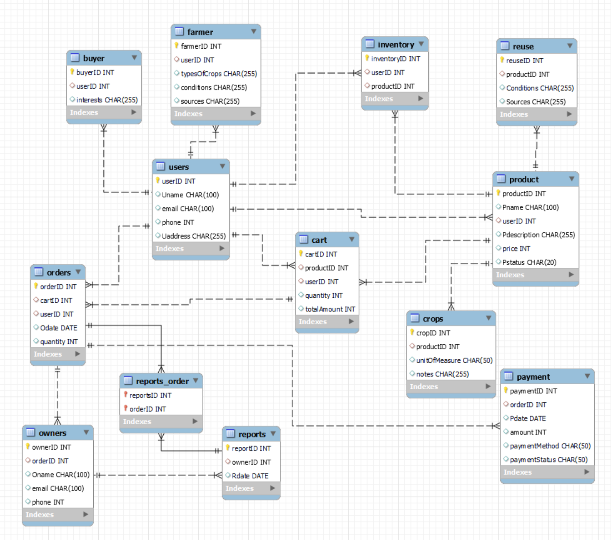
Physical Schema

Slide 24
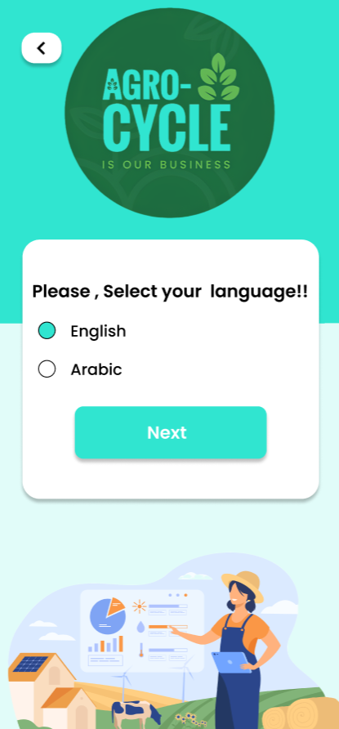

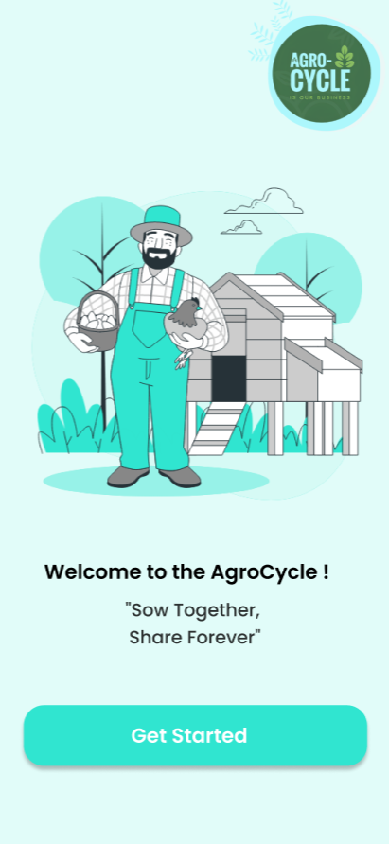
Landing Page

Slide 29
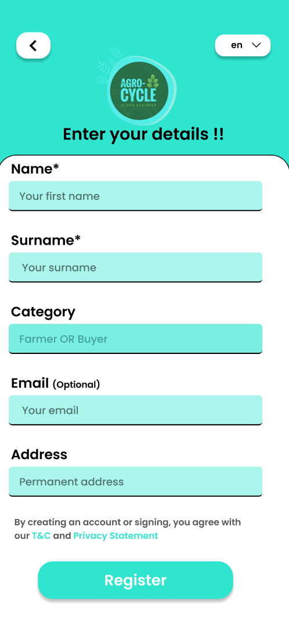
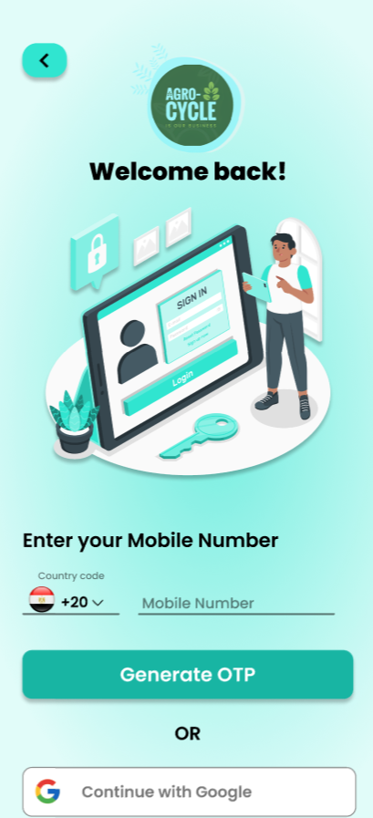
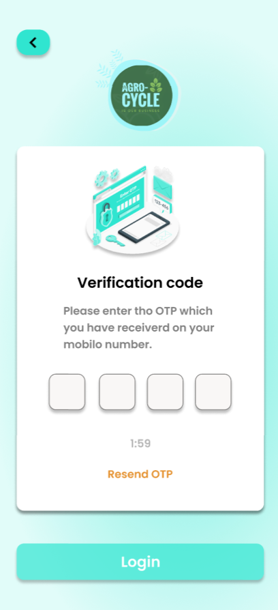
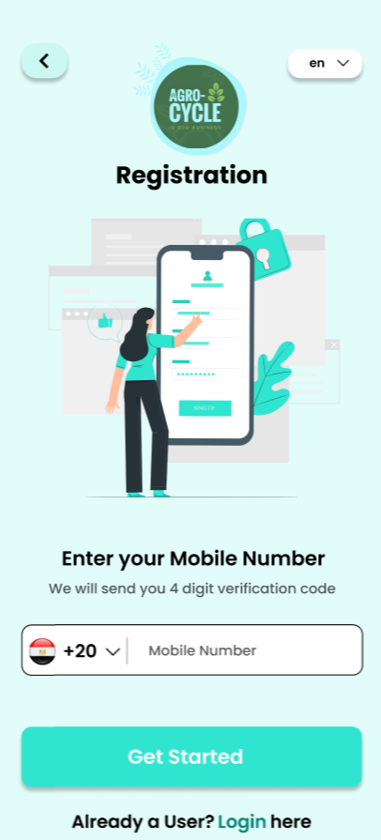
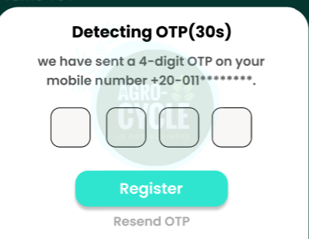
Registration Page

Slide 36
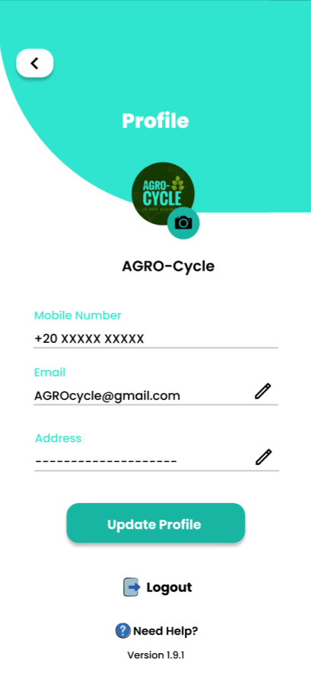
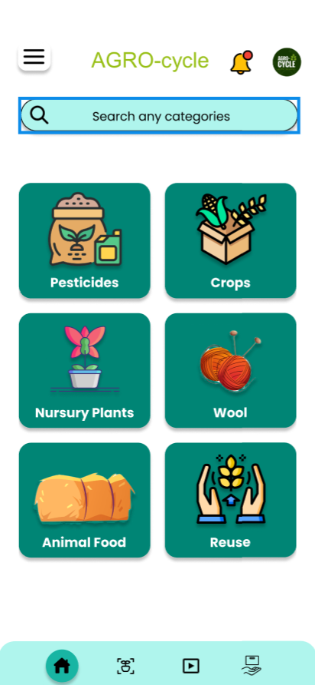
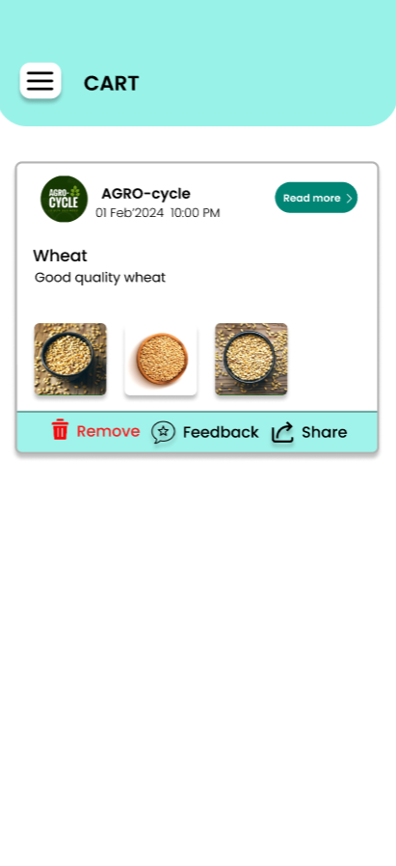
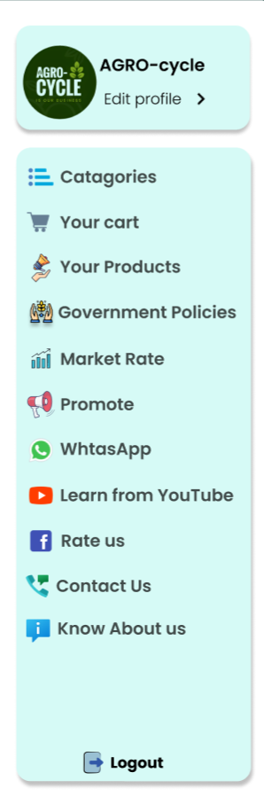
Dashboard , Profile , Side Menu Bar , Cart

Slide 42
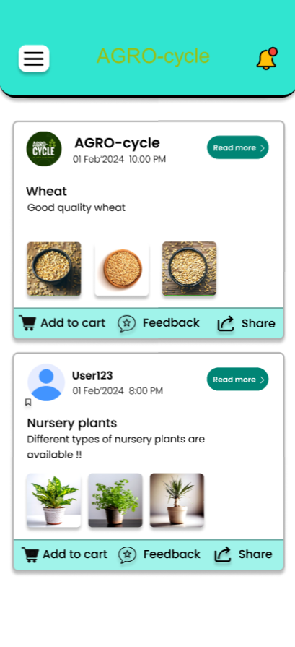
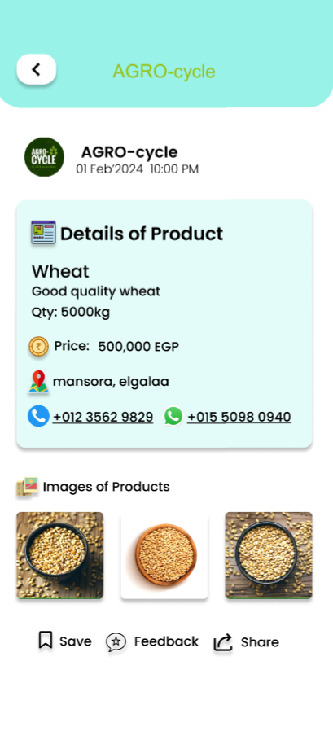
Buy section

Slide 46
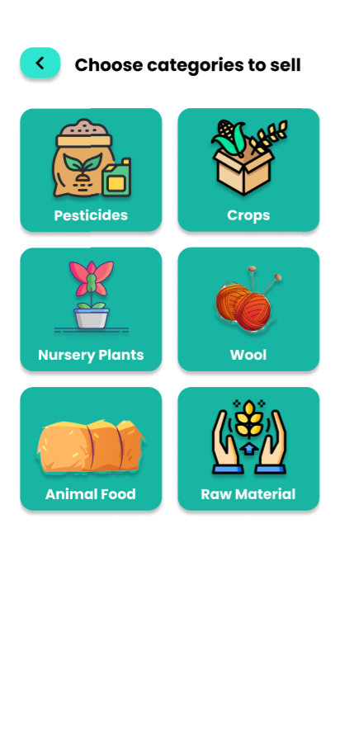
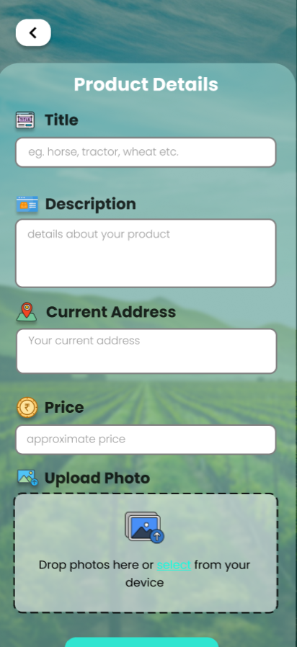
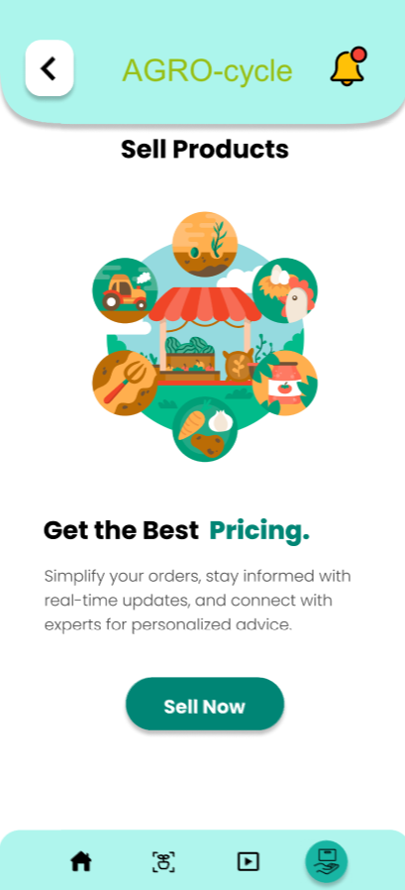
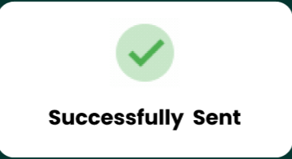
sell section

Slide 52
By leveraging technology, our app aims to transform Egypt's agricultural sector, making it more efficient, fair, and sustainable. This platform will empower farmers and satisfy buyers, ultimately contributing to the overall economic growth of the country. Are you join Us remaintaining our Agro_cycle?
Conclusion

Slide 53
Thanks!

